Slide 1
Employee Attrition Analysis Report
Swapnil Gavali

Slide 2
Objective
Understand the Significance of Sales Management: Recognize the increasing competition in the market and the necessity for enhanced distribution methods to reduce costs and boost profits.
Highlight the Importance of Sales Management in Enterprises: Acknowledge that sales management is currently the most crucial function in commercial and business enterprises.
Explore ETL Processes: Implement Extract-Transform-Load (ETL) processes on the Amazon dataset to facilitate efficient data analysis.
Uncover Key Metrics and Factors: Employ data analysis techniques to identify key metrics and factors influencing sales, contributing to a deeper comprehension of the underlying dynamics.
Establish Relationships Between Attributes: Utilize data visualization tools such as Tableau or Power BI to illustrate meaningful relationships between various attributes, aiding in the identification of patterns and insights.

Slide 3
Benefits
The insights gained from the analysis contribute to better decision-making, helping organizations respond proactively to market dynamics and changing customer preferences.
Analyzing customer trends and satisfaction allows businesses to identify areas for improvement in existing products and services.
The data-driven approach facilitates the development of new and better offerings, aligning with customer expectations and market demands.
The analysis provides a comprehensive view of customer behavior and preferences, enabling businesses to tailor their strategies to meet specific customer needs.
Understanding customer demographics, purchasing patterns, and preferences helps in building targeted marketing campaigns and personalized customer experiences.

Slide 4
Key Insights
EMPLOYEE
4410
ATTRITION
711
ATTRITION RATE
16.1%
AVERAGE AGE
37
AVERAGE SALARY
65K
AVERAGE YEARS
AT COMPANY
7.0

Slide 5
Attritions by Job role
Sales Executive recorded the highest Sum of Attrition Count at 165. This count was 685.71% higher than the lowest, which was in the Human Resources role at 21.
Sales Executive's attrition count represented 23.21% of the total.
Research Scientist and Laboratory Technician roles followed with notable attrition counts.
Across all 9 Job Roles, the Sum of Attrition Count ranged from 21 to 165, showcasing diverse attrition levels within different positions.

Slide 6
Attritions by salary slab
The Salary Slab "25k-45k" had the highest Count of Attrition at 1,275.
This count was remarkably higher, with a 2,136.84% difference, than the lowest Count of Attrition in the "5k-15k" range, which stood at 57.
"25k-45k" accounted for 28.91% of the overall Count of Attrition.
Across all 6 Salary Slabs, the Count of Attrition exhibited a range from 57 to 1,275, indicating diverse attrition levels within different salary categories.

Slide 7
Attritions by Education field
Life Sciences represents the majority of attrition in the dataset, accounting for 42.62% of the total attrition count.
Medical fields contribute the second-highest share with 31.72%, followed by Marketing at 10.59%.
Technical Degree and Human Resources make up 6.34% and 4.66%, respectively, while Other fields account for 4.23% of the attrition.

Slide 8
Attritions by age group
The "26-35" age group recorded the highest Sum of Attrition Count at 348.
This count was significantly higher, with a 1,350.00% difference, than the lowest Sum of Attrition Count in the "55" age group, which stood at 24.
"26-35" accounted for 48.95% of the overall Sum of Attrition Count.
Across all 5 Age Groups, the Sum of Attrition Count exhibited a range from 24 to 348, indicating diverse attrition levels within different age categories.

Slide 9
Attritions by years at company
Across all 37 Years At Company, the Count of Attrition ranged from 3 to 588.
The value of 5 accounted for the highest Count of Attrition at 588, representing 13.33% of the total.
Following closely, counts for Years At Company 1 and 3 were also notable.
This data suggests a varied distribution of attrition across different years of employment, with the highest count observed at 5 years.

Slide 10
Attritions by distance from home
The "2" Distance From Home category had the highest Count of Attrition at 633.
This count was significantly higher, with a 1,658.33% difference, than the lowest Count of Attrition in the "27" category, which stood at 36.
Distance From Home category "2" accounted for 14.35% of the overall Count of Attrition.
The highest counts of Attrition were observed in categories 2, 1, and 10, while the lowest count was in category 27.
Across all 29 Distance FromHome categories, the Count of Attrition ranged from 36 to 633, indicating diverse attrition levels related to distance from the workplace.

Slide 11
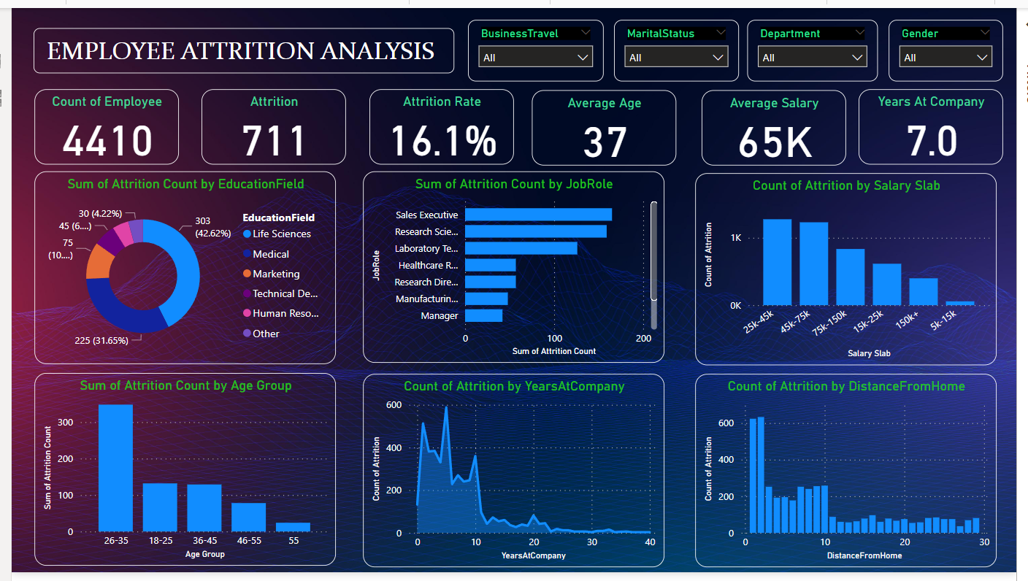
My power bi dashboard

Slide 12

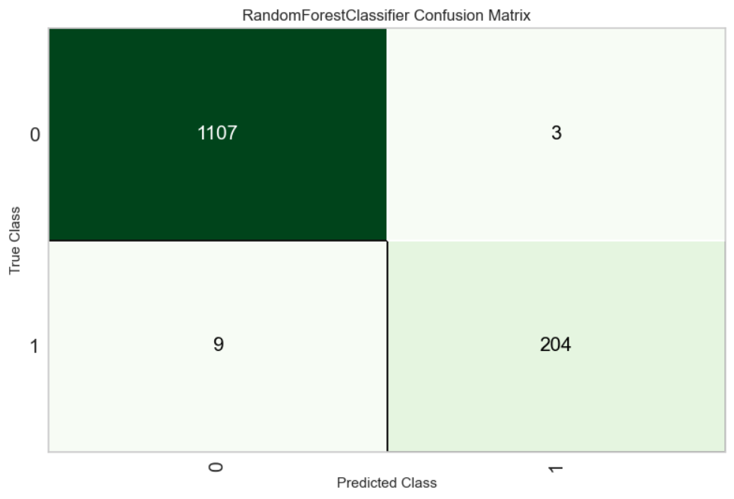
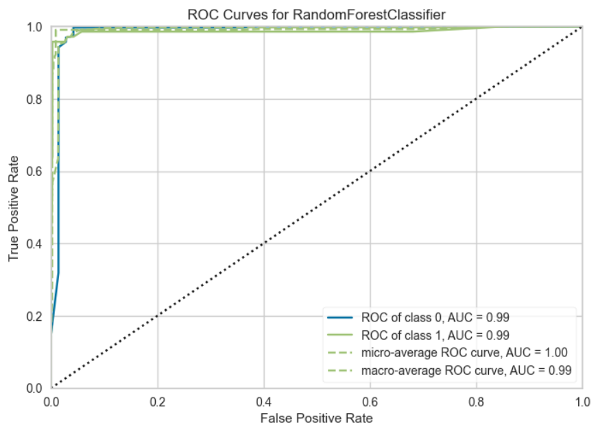
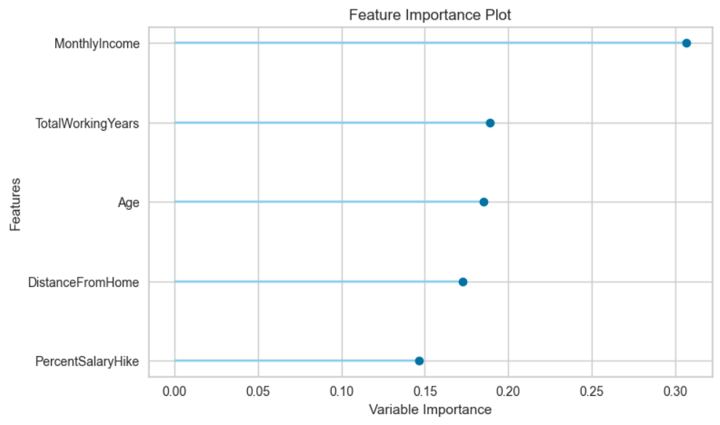
Random forest classifier performance

Slide 13
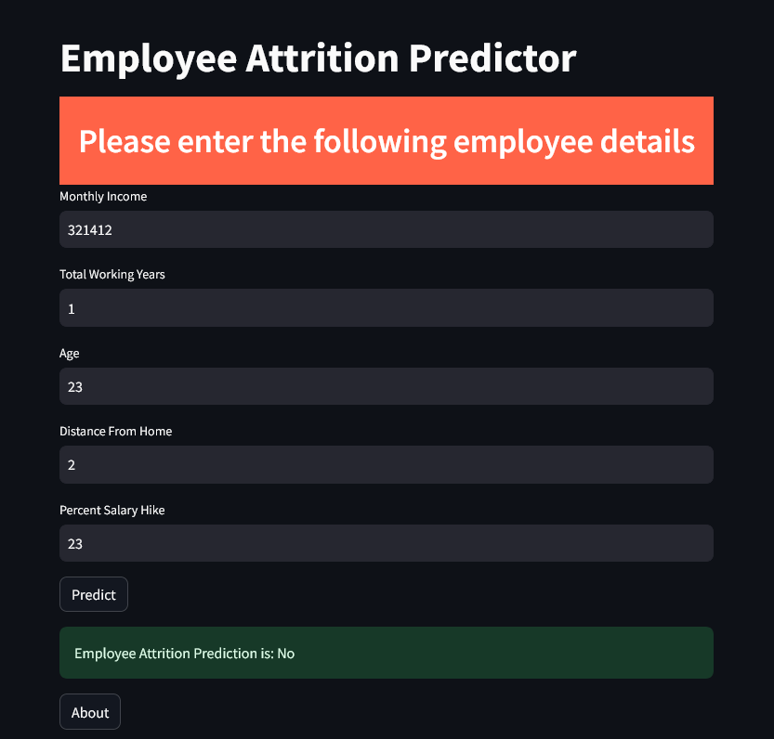
My web app

Slide 14
Conclusion
"26-35" age group recorded the highest Sum of Attrition Count at 348, significantly higher (1,350.00%)
than the lowest in the "55" age group at 24.
"25k-45k" Salary Slab had the highest Count of Attrition at 1,275, a remarkable 2,136.84% higher than
the lowest "5k-15k" at 57.
Sales Executive role had the highest Sum of Attrition Count at 165, representing 23.21% of the total,
685.71% higher than the lowest in Human Resources at 21.
Across all 37 Years At Company, the Count of Attrition ranged from 3 to 588, with the highest count
observed at 5 years.
The diverse distribution of Sum of Attrition Count across all 9 Job Roles ranged from 21 to 165, indicating
varied attrition levels within different positions.
Overall, the analysis provides insights into different facets of attrition, offering valuable information for
tailored retention strategies in organizations.
The Random Forest Classifier demonstrates high performance with an accuracy of 99.09%.

